Slide 1
PersonAI
By : Julian Berrio, Kimberly Germinal, and Michael Rogatinsky

Slide 2
WHAT DOES IT DO ?
This app is designed to help children and teenagers stay organized for school and adapt to the routine of the user's lifestyle.
When rotated horizontally, the app consists of a Calendar view as well as buttons to add/drop events.
In the app you will be able to input your class schedule and record your homework, events, projects, etc that you plan to work on throughout each week.
This app will help you keep up with what’s due when and create a more efficient way to stay organized for school.

Slide 3
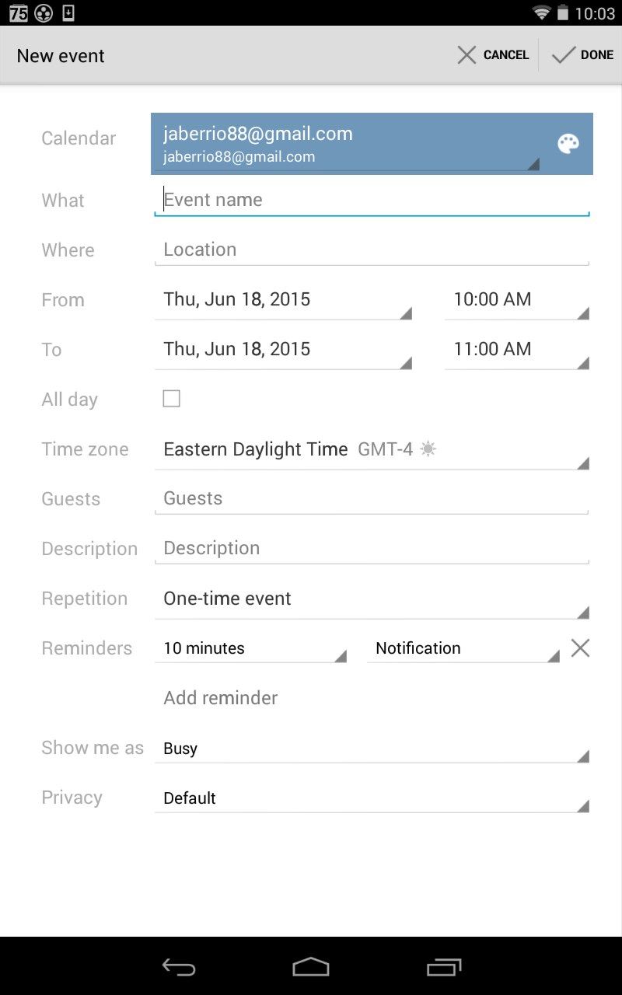
OVERVIEW
Unlike google calendar’s generic and impersonal methods for inputting events, our app caters particularly to students.
We can take a math class for example students normally having textbook work. There would be a custom field for page number, problem numbers , odd, even, all, ect.
Multiple subjects will be pre-made much as Math, Writing, Science , Online Class, and many more.
Option to make your own custom templates for fields.

Slide 4
STYLE AND DESIGN
The theme of the app will focus around a sketch book atmosphere that helps the consumer feel more comfortable with the app.
Incorporated into the app will be everyday sketches that children draw in their notebooks as backgrounds of the app.
-Black and White sketchbook style with an occasional splash of color.
-Drawings to establish personality and help draw the consumers attentions.

Slide 5
SPECIAL FUNCTIONS
How is this app different from other organizer apps?
This app will have pre made templates to allow the student to input information quickly whenever he or she is free.
personAL will have custom fields tailored to each student. This includes but not limited to fields of textbook, workbook, essay, events, after school reminders, picture notes, review, and a custom template creator.
In each field you should be able to input quickly data such as page numbers, number of problems, even or odds, due date, and place each subject based on the content of day.

Slide 6
ADDITIONAL FEATURES
Sensors
Camera- Can add quick reminders to allow to user to remember information or to input an event for a later time.
NFC tag
Graphics
Buttons with background pictures
Mean teacher/ Nice teacher icons

Slide 7
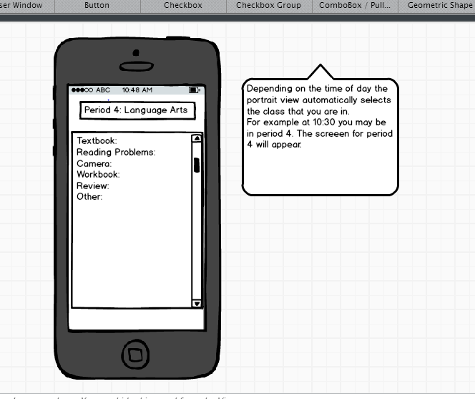
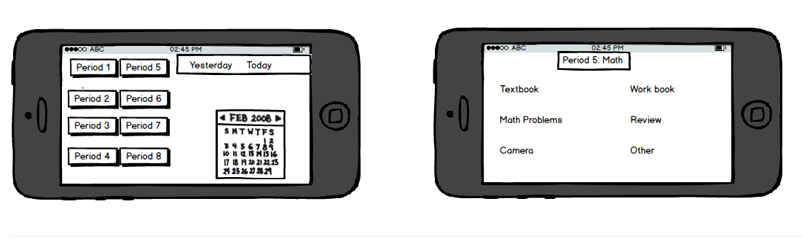
What it should look like

